Slide 1
Apple Dark
iOS Gesture Detection App with support for low-light and no-light environments
Pallav Hingu

Slide 2
Features
Detecting Hand Gestures using the LiDAR or True Depth camera
“Jelly Switch Simulation” - Detecting specific head gestures
Extend to work in the dark

Slide 3
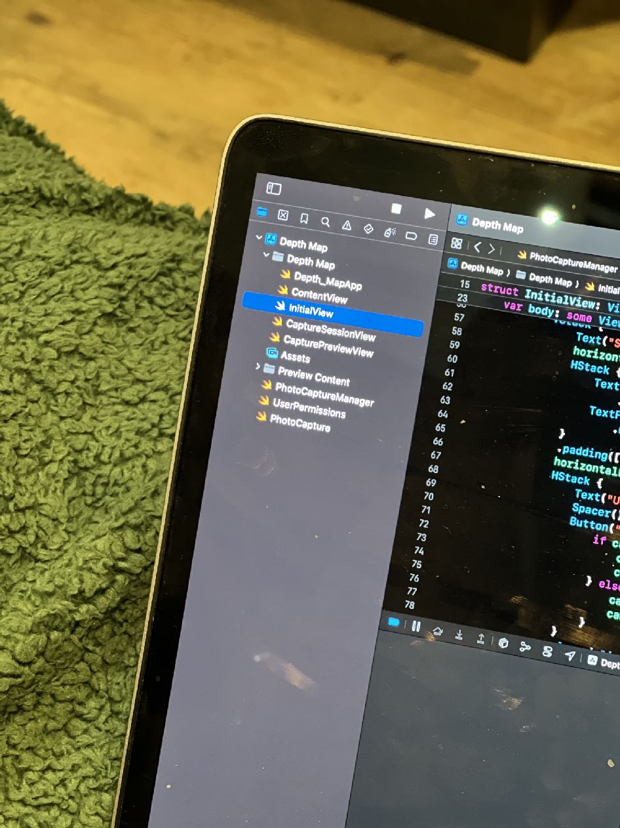
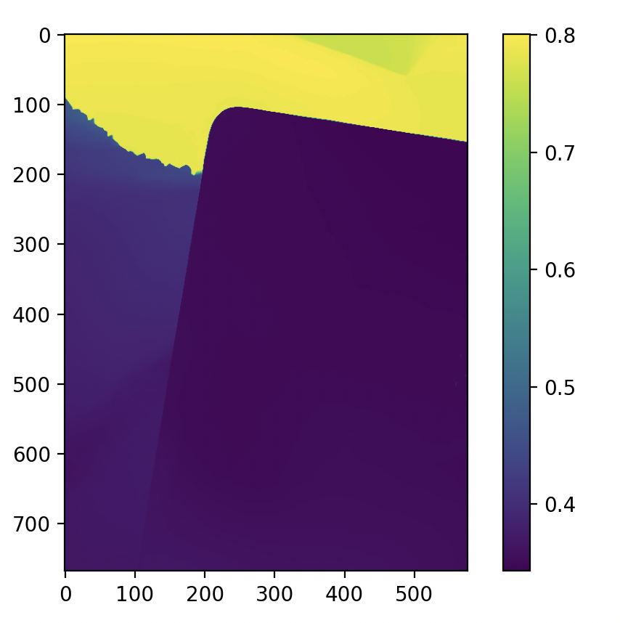
Harnessing data from depth sensors
Good lighting
Original photo taken on phone
Image created using pure depth data stream provided by iOS

Slide 4
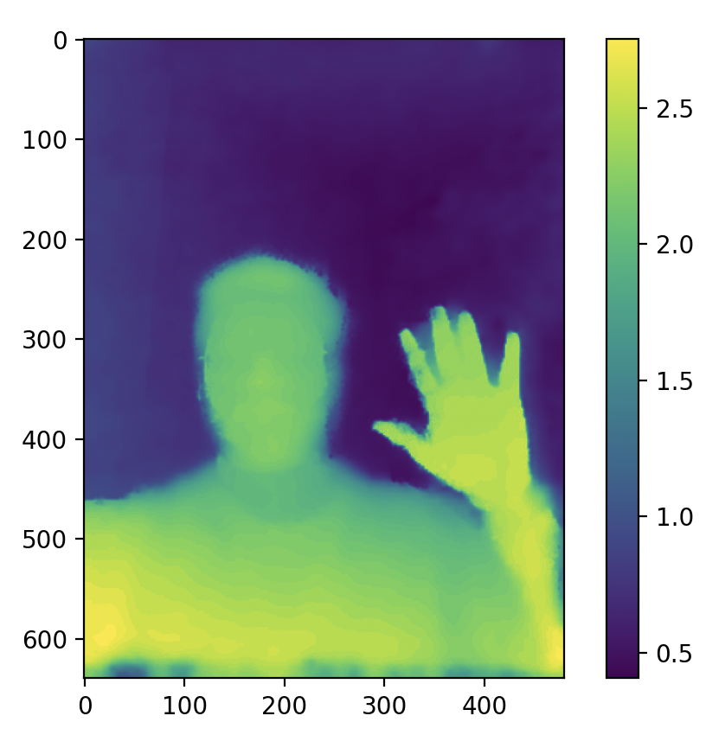
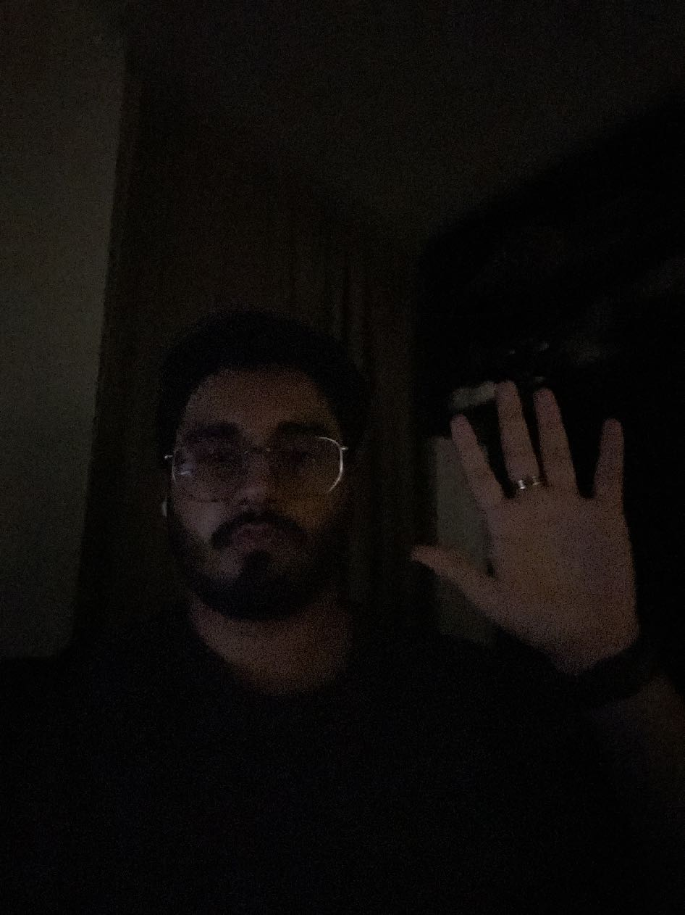
Harnessing data from depth sensors
Bad lighting
Original photo taken on phone
Image created using pure depth data stream provided by iOS

Slide 5

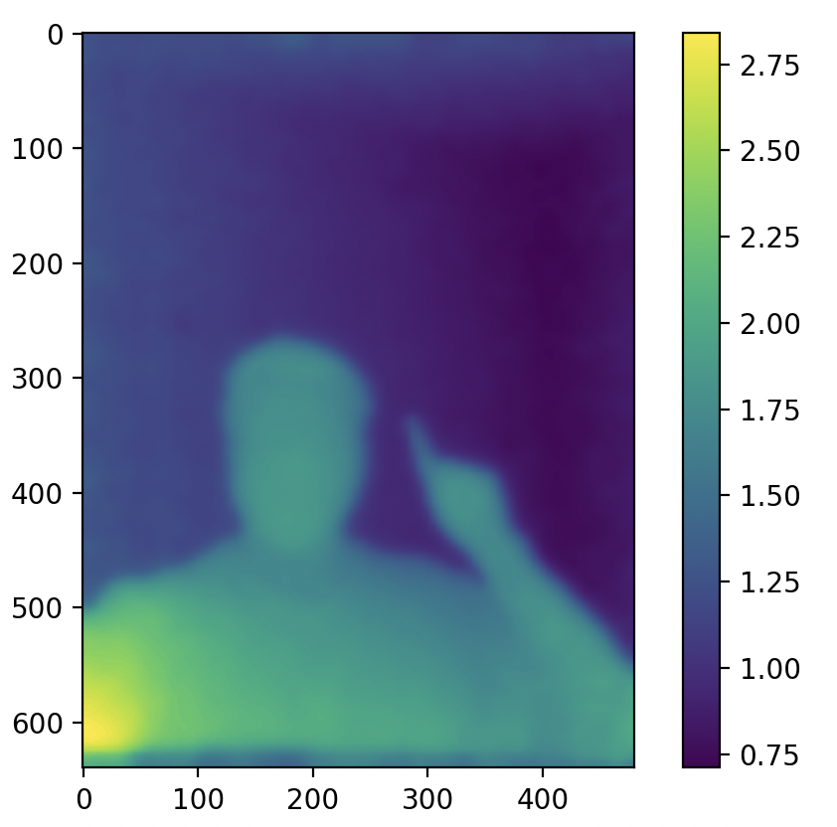
Harnessing data from depth sensors
NO light
Original photo taken on phone
Image created using pure depth data stream provided by iOS

Slide 6
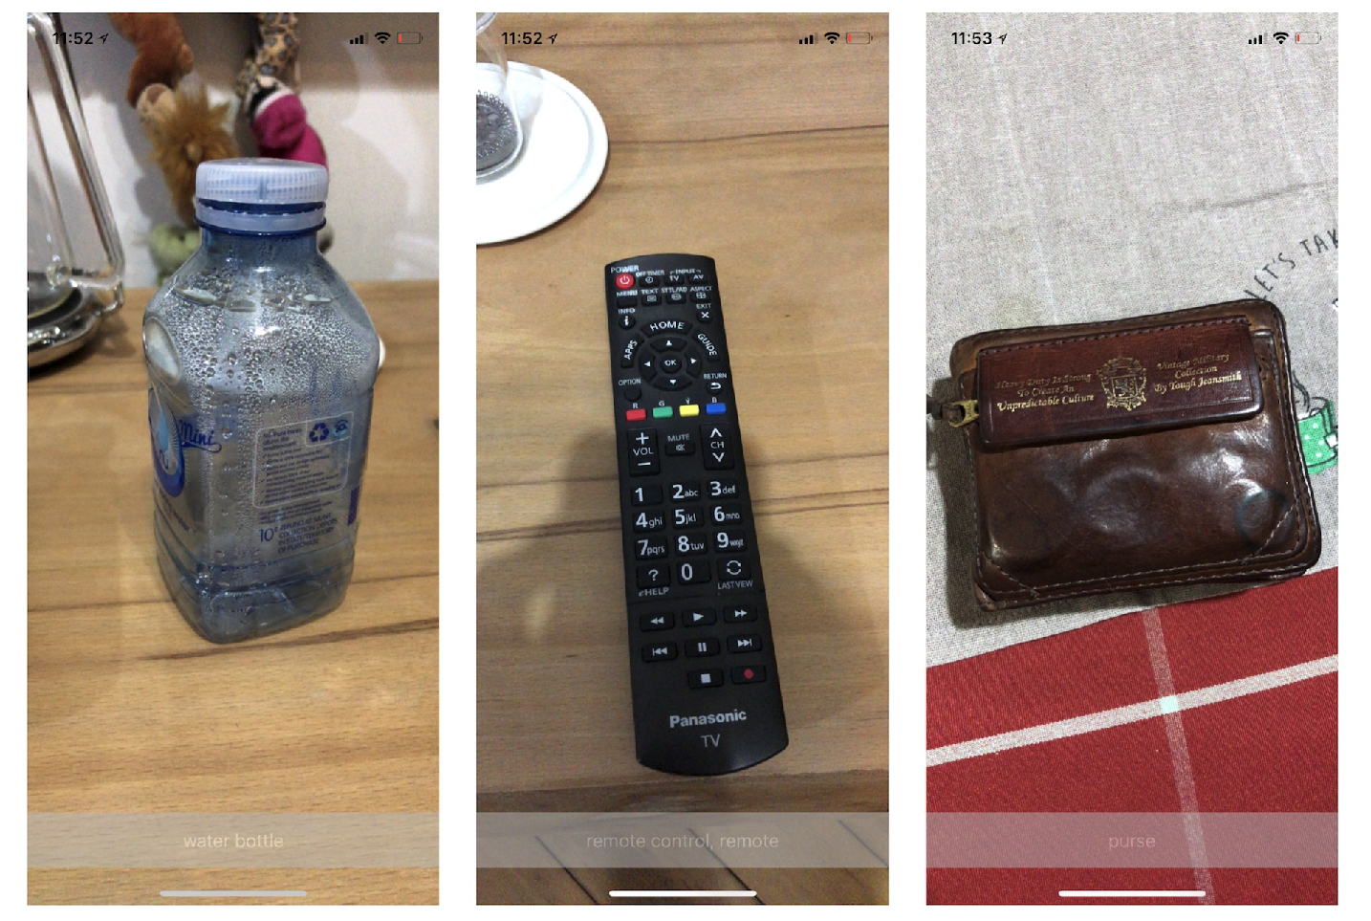
Plans
Complete creating an intial database of depth maps of different gestures being performed
Experiment with various models such as CNNs, 3D-CNNs and PointCNN (may be overkill) in Python
Use Core ML Tools to convert PyTorch or tensor flow models to Core ML Models
Implement into a basic live video feed classification application (similar applications exist with different models being used)

Slide 7
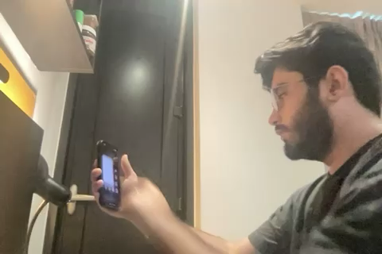
Features
Head Tracking
Initial changing colours based on face tracking
Uses Apple APIs to allow for usage of a combination of LiDAR and image data
Recenter button to reset drift when phone has been moved

